Slide 1
Q-Learning
Hung-yi Lee
Notes:
https://www.youtube.com/watch?v=ycCtmp4hcUs&list=PLkFD6_40KJIznC9CDbVTjAF2oyt8_VAe3&index=14
PPO12
To do:
Q basic
Double, Dueling, Multi, conti
Noisy and Distribute
Q: why distributional?????
Noisy net 好在哪?

Slide 2
Outline
Introduction of Q-Learning
Tips of Q-Learning
Q-Learning for Continuous Actions

Slide 3
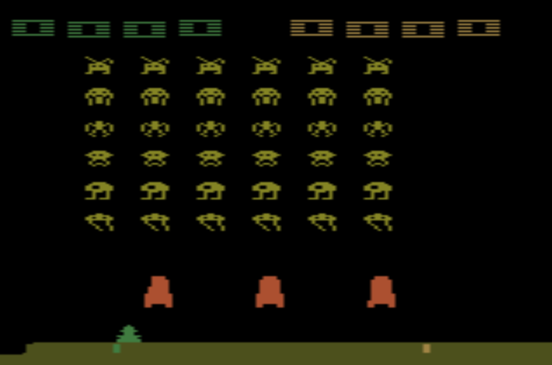
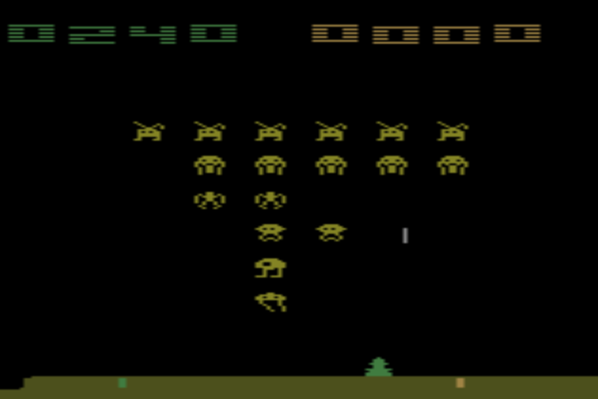
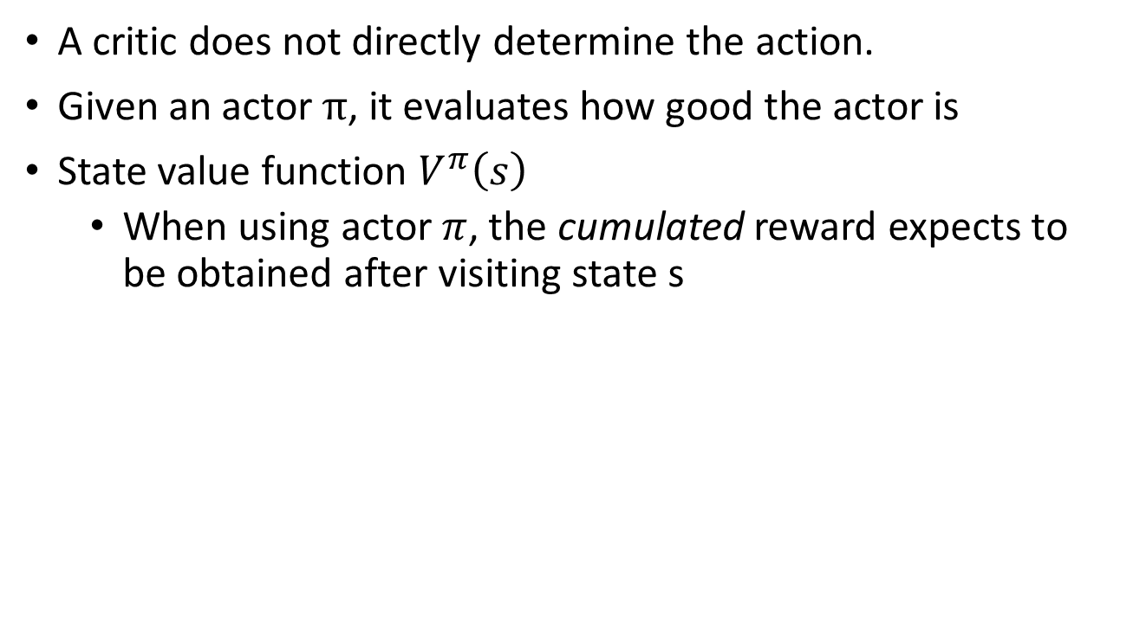
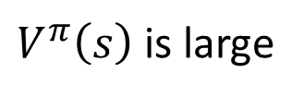
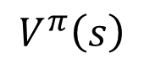
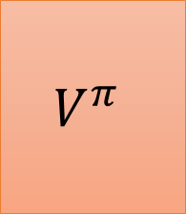
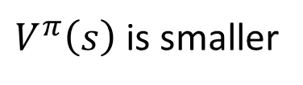
Critic
The output values of a critic depend on the actor evaluated.
A critic does not directly determine the action.
Given an actor $π$, it evaluates how good the actor is
State value function $V^{π}\left(s\right)$
When using actor $π$, the cumulated reward expects to be obtained after visiting state s
$$V^{π}$$
$$V^{π}\left(s\right)$$
s
scalar
$V^{π}\left(s\right)$ is large
$V^{π}\left(s\right)$ is smaller
Notes:
(Lots of aliens to be killed, and the shields still exist)

Slide 4
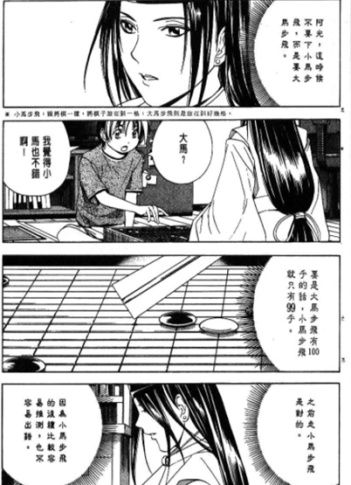
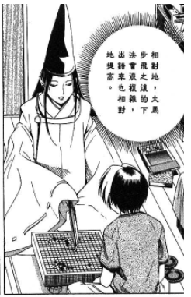
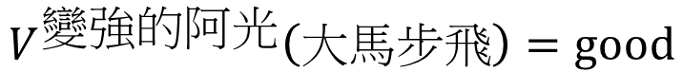
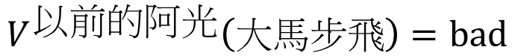
Critic
$$V^{以前的阿光}\left(大馬步飛\right)=bad$$
$$V^{變強的阿光}\left(大馬步飛\right)=good$$
Notes:
http://combiboilersleeds.com/picaso/critics/critics-4.html

Slide 5
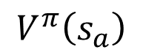
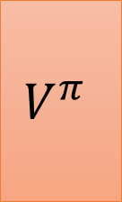
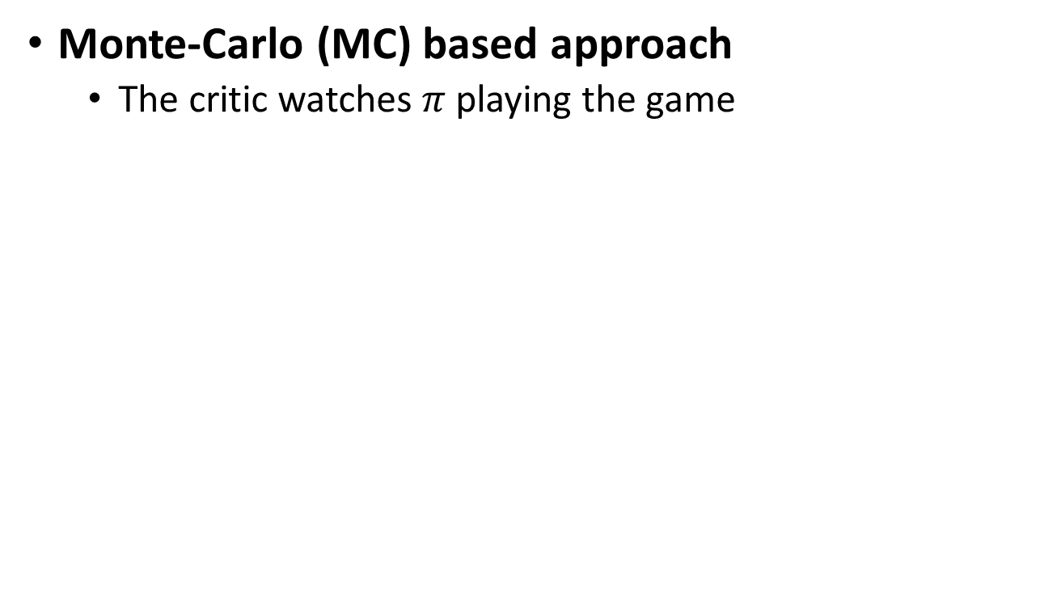
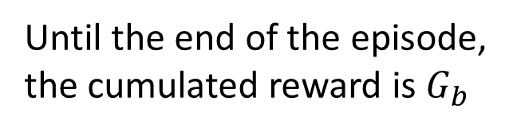
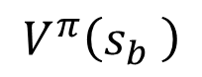
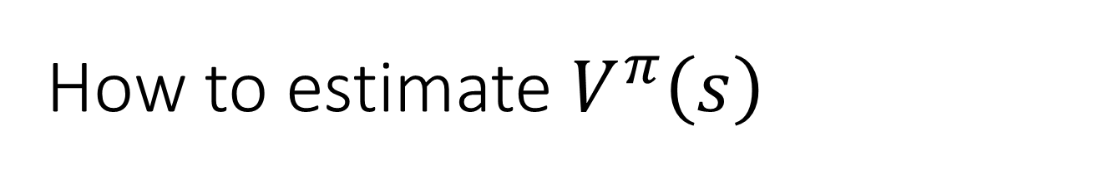
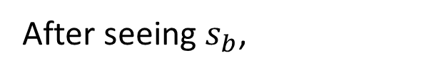
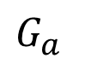
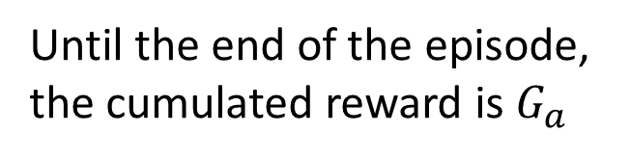
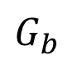
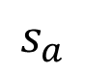
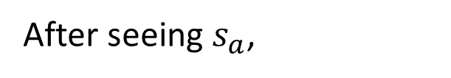

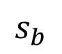
How to estimate $V^{π}\left(s\right)$
Monte-Carlo (MC) based approach
The critic watches $π$ playing the game
After seeing $s_{a}$,
$$V^{π}$$
Until the end of the episode, the cumulated reward is $G_{a}$
$$s_{a}$$
$$V^{π}\left(s_{a}\right)$$
$G_{a}$
After seeing $s_{b}$,
$$V^{π}$$
Until the end of the episode, the cumulated reward is $G_{b}$
$$s_{b}$$
$$V^{π}\left(s_{b} \right)$$
$G_{b}$

Slide 6
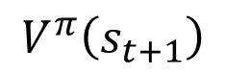
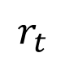
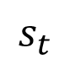
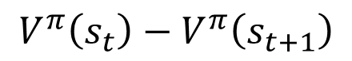

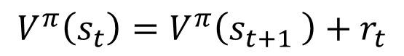
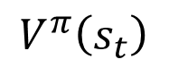
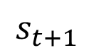
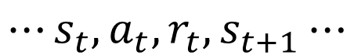

How to estimate $V^{π}\left(s\right)$
Temporal-difference (TD) approach
$$⋯s_{t},a_{t},r_{t},s_{t+1}⋯$$
$$V^{π}$$
$$V^{π}\left(s_{t}\right)=V^{π}\left(s_{t+1} \right)+r_{t}$$
$$s_{t}$$
$$V^{π}\left(s_{t}\right)$$
-
$$V^{π}\left(s_{t}\right)−V^{π}\left(s_{t+1}\right)$$
$$r_{t}$$
$$V^{π}$$
$$s_{t+1}$$
$$V^{π}\left(s_{t+1}\right)$$
Some applications have very long episodes, so that delaying all learning until an episode's end is too slow.
Notes:
The next most obvious advantage of TD methods over Monte Carlo methods is
that they are naturally implemented in an on-line, fully incremental fashion. With
Monte Carlo methods one must wait until the end of an episode, because only then
is the return known, whereas with TD methods one need wait only one time step.
Surprisingly often this turns out to be a critical consideration Other applications are continuing tasks and have no episodes at all.

Slide 7

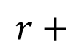

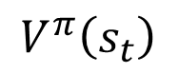
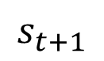
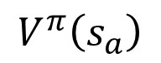

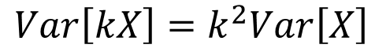
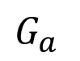
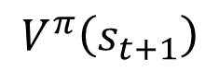
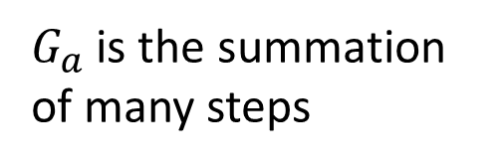
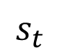
MC v.s. TD
$$Var\left[kX\right]=k^{2}Var\left[X\right]$$
$$V^{π}$$
Larger variance
$$s_{a}$$
$$V^{π}\left(s_{a}\right)$$
$G_{a}$
$G_{a}$ is the summation of many steps
$$V^{π}$$
$$V^{π}$$
$$s_{t}$$
$$V^{π}\left(s_{t}\right)$$
$$r+$$
$$V^{π}\left(s_{t+1}\right)$$
$$s_{t+1}$$
Smaller variance
May be inaccurate

Slide 8
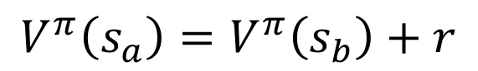
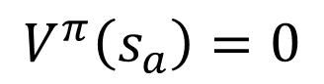
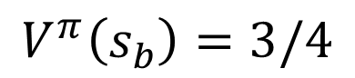
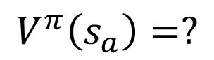
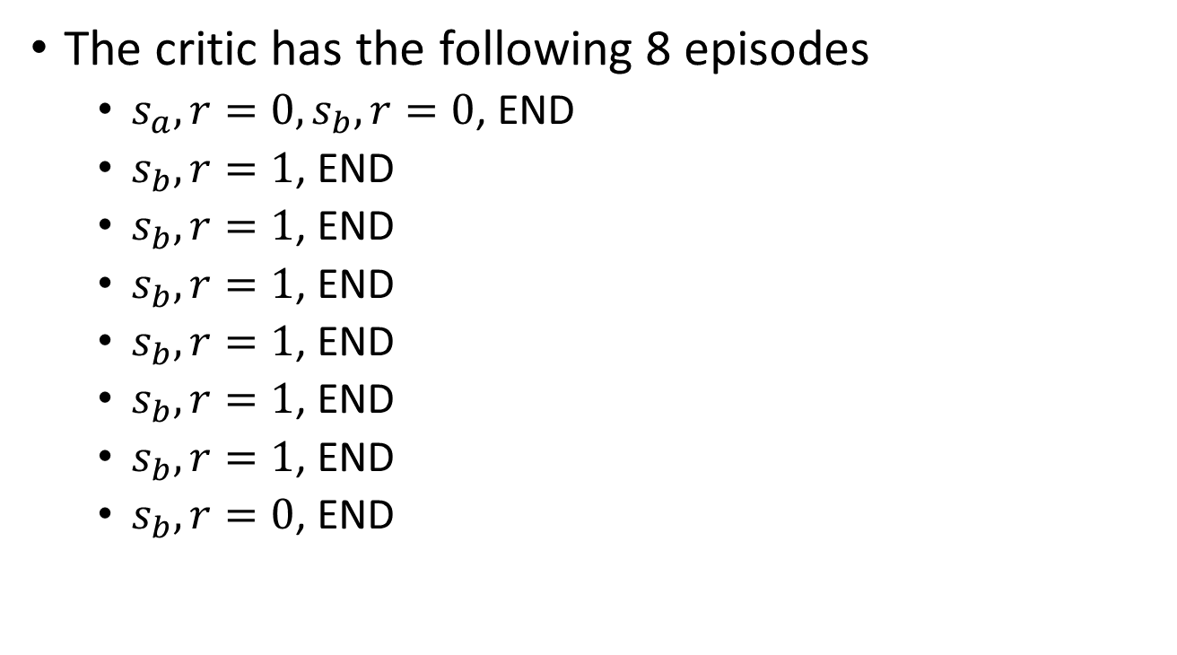
MC v.s. TD
[Sutton, v2, Example 6.4]
The critic has the following 8 episodes
$s_{a},r=0,s_{b},r=0$, END
$s_{b},r=1$, END
$s_{b},r=1$, END
$s_{b},r=1$, END
$s_{b},r=1$, END
$s_{b},r=1$, END
$s_{b},r=1$, END
$s_{b},r=0$, END
$$V^{π}\left(s_{b}\right)=3/4$$
$$V^{π}\left(s_{a}\right)=?$$
0?
3/4?
Monte-Carlo:
$$V^{π}\left(s_{a}\right)=0$$
Temporal-difference:
$$V^{π}\left(s_{a}\right)=V^{π}\left(s_{b}\right)+r$$
3/4
3/4
0
(The actions are ignored here.)

Slide 9
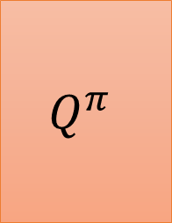

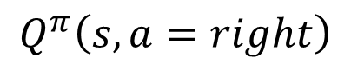
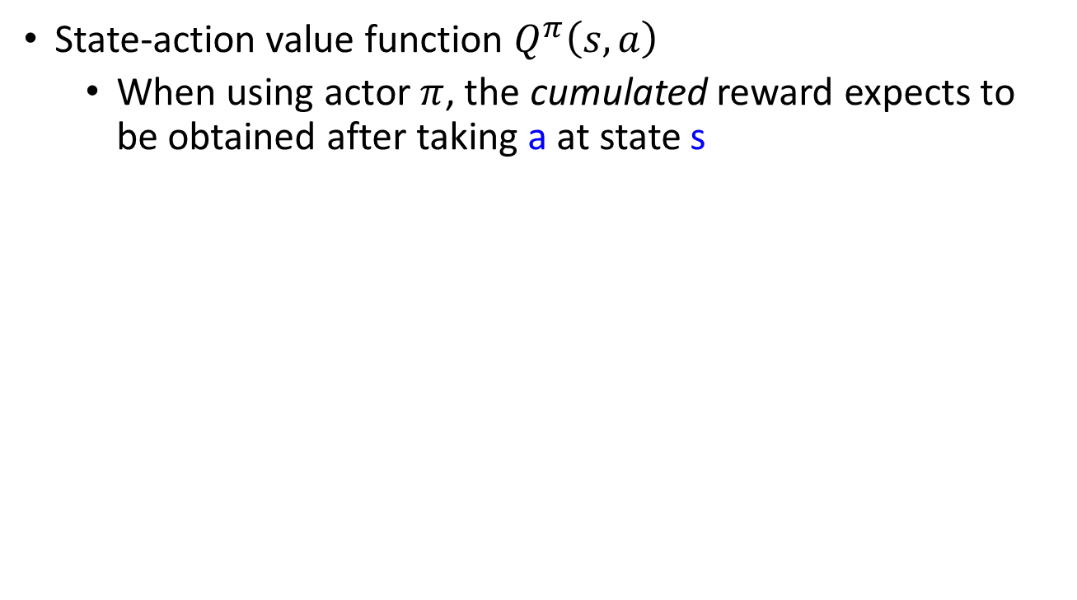
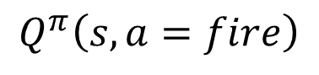


Another Critic
State-action value function $Q^{π}\left(s,a\right)$
When using actor $π$, the cumulated reward expects to be obtained after taking a at state s
$$Q^{π}$$
$$Q^{π}$$
$$Q^{π}\left(s,a=left\right)$$
s
$$Q^{π}\left(s,a\right)$$
s
$$Q^{π}\left(s,a=right\right)$$
scalar
a
$$Q^{π}\left(s,a=fire\right)$$
for discrete action only

Slide 10

State-action value function
https://web.stanford.edu/class/psych209/Readings/MnihEtAlHassibis15NatureControlDeepRL.pdf

Slide 11

Another Way to use Critic: Q-Learning
$π$ interacts with the environment
𝜋 interacts with the environment
Learning $Q^{π}\left(s,a\right)$
Learning 𝑄^𝜋 (𝑠,𝑎)
Find a new actor $π^{′}$ “better” than $π$
Find a new actor 𝜋^′ “better” than 𝜋
$$π=π^{′}$$
TD or MC
?
Notes:
Add some noise

Slide 12



Q-Learning
Given $Q^{π}\left(s,a\right)$, find a new actor $π^{′}$ “better” than $π$
“Better”: $V^{π^{′}}\left(s\right)≥V^{π}\left(s\right)$, for all state s
$$π^{′}\left(s\right)=arg\max_{a}{Q^{π}\left(s,a\right)}$$
$π^{′}$ does not have extra parameters. It depends on Q
Not suitable for continuous action a (solve it later)

Slide 13








Q-Learning
$$π^{′}\left(s\right)=arg\max_{a}{Q^{π}\left(s,a\right)}$$
$V^{π^{′}}\left(s\right)≥V^{π}\left(s\right)$, for all state s
$$V^{π}\left(s\right)=Q^{π}\left(s,π\left(s\right)\right)$$
$$≤\max_{a}{Q^{π}\left(s,a\right)}$$
$$=Q^{π}\left(s,π^{′}\left(s\right)\right)$$
$$V^{π}\left(s\right)$$
$$≤Q^{π}\left(s,π^{′}\left(s\right)\right)$$
$$=E[r_{t+1}+V^{π}\left(s_{t+1}\right)|s_{t}=s,a_{t}=π^{′}\left(s_{t}\right)]$$
$$≤E[r_{t+1}+Q^{π}\left(s_{t+1},π^{′}\left(s_{t+1}\right)\right)|s_{t}=s,a_{t}=π^{′}\left(s_{t}\right)]$$
$$=E[r_{t+1}+r_{t+2}+V^{π}\left(s_{t+2} \right)|…]$$
$$≤E[r_{t+1}+r_{t+2}+Q^{π}\left(s_{t+2},π^{′}\left(s_{t+2}\right)\right)|…]$$
$…$ $≤$ $V^{π^{′}}\left(s\right)$

Slide 14












Target Network
$$⋯s_{t},a_{t},r_{t},s_{t+1}⋯$$
$$Q^{π}\left(s_{t},a_{t}\right)$$
$$=r_{t}+Q^{π}\left(s_{t+1},π\left(s_{t+1}\right)\right)$$
$$Q^{π}$$
$$s_{t}$$
$$Q^{π}\left(s_{t},a_{t}\right)$$
Target Network
$$a_{t}$$
regression
update
$$Q^{π}$$
$$s_{t+1}$$
$$r_{t}+$$
$$Q^{π}\left(s_{t+1},π\left(s_{t+1}\right)\right)$$
fixed value
$$π\left(s_{t+1}\right)$$
fixed
After updating N times

Slide 15













Exploration
$$a_{1}$$
$$Q\left(s,a\right)=0$$
Never explore
$$s$$
$$a_{2}$$
1
Always sampled
$$Q\left(s,a\right)=0$$
$$a_{3}$$
$$Q\left(s,a\right)=0$$
Never explore
The policy is based on Q-function
This is not a good way for data collection.
$$a=arg\max_{a}{Q\left(s,a\right)}$$
Epsilon Greedy
$ε$ would decay during learning
$$a=\left\{\begin{aligned}arg\max_{a}{Q\left(s,a\right)}, \\ &random, \end{aligned}\right.$$
$$with probability 1−ε$$
$$otherwise$$
Boltzmann Exploration
$$P\left(a|s\right)=\frac{exp\left(Q\left(s,a\right)\right)}{\sum_{a}{exp\left(Q\left(s,a\right)\right)}}$$
Notes:
就好像去餐廳點一道菜

Slide 16


Replay Buffer
…
Buffer
exp
exp
Put the experience into buffer.
$$s_{t},a_{t},r_{t},s_{t+1}$$
exp
$π$ interacts with the environment
𝜋 interacts with the environment
Learning $Q^{π}\left(s,a\right)$
Learning 𝑄^𝜋 (𝑠,𝑎)
Find a new actor $π^{′}$ “better” than $π$
Find a new actor 𝜋^′ “better” than 𝜋
exp
…
The experience in the buffer comes from different policies.
$$π=π^{′}$$
Drop the old experience if the buffer is full.

Slide 17
Replay Buffer
…
Buffer
exp
exp
Put the experience into buffer.
$$s_{t},a_{t},r_{t},s_{t+1}$$
exp
$π$ interacts with the environment
𝜋 interacts with the environment
Learning $Q^{π}\left(s,a\right)$
Learning 𝑄^𝜋 (𝑠,𝑎)
Find a new actor $π^{′}$ “better” than $π$
Find a new actor 𝜋^′ “better” than 𝜋
exp
…
$$π=π^{′}$$
In each iteration:
1. Sample a batch
2. Update Q-function
Off-policy

Slide 18

Typical Q-Learning Algorithm
Initialize Q-function $Q$, target Q-function $\hat{Q}=Q$
In each episode
For each time step t
Given state $s_{t}$, take action $a_{t}$ based on Q (epsilon greedy)
Obtain reward $r_{t}$, and reach new state $s_{t+1}$
Store ($s_{t}$, $a_{t}$, $r_{t}$, $s_{t+1}$) into buffer
Sample ($s_{i}$, $a_{i}$, $r_{i}$, $s_{i+1}$) from buffer (usually a batch)
Target $y=r_{i}+\max_{a}{\hat{Q}\left(s_{i+1},a\right)}$
Update the parameters of $Q$ to make $Q\left(s_{i}\text{, }a_{i}\right)$ close to $y$ (regression)
Every C steps reset $\hat{Q}=Q$

Slide 19
Outline
Introduction of Q-Learning
Tips of Q-Learning
Q-Learning for Continuous Actions

Slide 20

Double DQN
Q value is usually over-estimated

Slide 21




Double DQN
Q value is usually over estimate
$$Q\left(s_{t},a_{t}\right)$$
$$r_{t}+\max_{a}{Q\left(s_{t+1},a\right)}$$
Tend to select the action that is over-estimated
$$Q\left(s_{t+1},a\right)$$

Slide 22


Double DQN
Q value is usually over estimate
Double DQN: two functions Q and Q’
$$Q\left(s_{t},a_{t}\right)$$
$$r_{t}+\max_{a}{Q\left(s_{t+1},a\right)}$$
Target Network
$$Q\left(s_{t},a_{t}\right)$$
$$r_{t}+Q′\left(s_{t+1},arg\max_{a}{Q\left(s_{t+1},a\right)}\right)$$
If Q over-estimate a, so it is selected. Q’ would give it proper value.
How about Q’ overestimate? The action will not be selected by Q.
Hado V. Hasselt, “Double Q-learning”, NIPS 2010
Hado van Hasselt, Arthur Guez, David Silver, “Deep Reinforcement Learning with Double Q-learning”, AAAI 2016

Slide 23

Dueling DQN
Ziyu Wang, Tom Schaul, Matteo Hessel, Hado van Hasselt, Marc Lanctot, Nando de Freitas, “Dueling Network Architectures for Deep Reinforcement Learning”, arXiv preprint, 2015
Q(s,a)
State
s
V(s)
State
s
Q(s,a)
= A(s,a)+V(s)
Only change the network structure
A(s,a)
Notes:
https://arxiv.org/pdf/1511.06581.pdf
For example: imagine sitting outside in a park watching the sunset. It is beautiful, and highly rewarding to be sitting there. No action needs to be taken, and it doesn’t really make sense to think of the value of sitting there as being conditioned on anything beyond the environmental state you are in. We can achieve more robust estimates of state value by decoupling it from the necessity of being attached to specific actions.

Slide 24

Dueling DQN
state
4
3 | 3 | 3 | 1
1 | -1 | 6 | 1
2 | -2 | 3 | 1
Q(s,a)
action
0
-1
=
=
V(s)
2 | 0 | 4 | 1
Average of column
1
+
+
1 | 3 | -1 | 0
-1 | -1 | 2 | 0
0 | -2 | -1 | 0
A(s,a)
sum of column = 0

Slide 25

Dueling DQN
1.0
7
3
2
3
-1
-2
Normalize A(s,a) before adding with V(s)

Slide 26

Dueling DQN - Visualization
(from the link of the original paper)

Slide 27

Dueling DQN - Visualization
(from the link of the original paper)

Slide 28








Prioritized Reply
https://arxiv.org/abs/1511.05952?context=cs
The data with larger TD error in previous training has higher probability to be sampled.
Experience
Buffer
$$\left(s_{t},a_{t},r_{t},s_{t+1}\right)$$
$$Q$$
$$s_{t}$$
Parameter update procedure is also modified.
$$Q\left(s_{t},a_{t}\right)$$
$$a_{t}$$
TD error
$$\hat{Q}$$
$$s_{t+1}$$
$$r_{t}+$$
$$\hat{Q}\left(s_{t+1},a_{t+1}\right)$$
$$a_{t+1}=arg\max_{a}{\hat{Q}\left(s_{t+1},a\right)}$$
$$a_{t+1}$$

Slide 29





Multi-step
Balance between MC and TD
$$\left(s_{t},a_{t},r_{t},⋯,s_{t+N},a_{t+N},r_{t+N},s_{t+N+1}\right)$$
Experience
Buffer
$$\left(s_{t},a_{t},r_{t},s_{t+1}\right)$$
$$Q$$
$$s_{t}$$
$$Q\left(s_{t},a_{t}\right)$$
$$a_{t+N+1}=arg\max_{a}{\hat{Q}\left(s_{t+N+1},a\right)}$$
$$a_{t}$$
$$\hat{Q}$$
$$s_{t+N+1}$$
$$\sum_{t^{′}=t}^{t+N}{r_{t^{′}}}+$$
$$\hat{Q}\left(s_{t+N+1},a_{t+N+1}\right)$$
$$a_{t+N+1}$$

Slide 30




Noisy Net
https://arxiv.org/abs/1706.01905
https://arxiv.org/abs/1706.10295
Noise on Action (Epsilon Greedy)
Noise on Parameters
$$a=\left\{\begin{aligned}arg\max_{a}{Q\left(s,a\right)}, \\ &random, \end{aligned}\right.$$
$$with probability 1−ε$$
$$otherwise$$
Inject noise into the parameters of Q-function at the beginning of each episode
$$a=arg\max_{a}{\tilde{Q}\left(s,a\right)}$$
$$Q\left(s,a\right)$$
$$\tilde{Q}\left(s,a\right)$$
Add noise
The noise would NOT change in an episode.
Notes:
https://blog.openai.com/better-exploration-with-parameter-noise/
Open AI
deep mind

Slide 31

Noisy Net
Noise on Action
Given the same state, the agent may takes different actions.
No real policy works in this way
Noise on Parameters
Given the same (similar) state, the agent takes the same action.
$⟶$ State-dependent Exploration
Explore in a consistent way
隨機亂試
有系統地試
Notes:
Benefit: “Structured Exploration”

Slide 32


Demo
https://blog.openai.com/better-exploration-with-parameter-noise/

Slide 33


Distributional Q-function
State-action value function $Q^{π}\left(s,a\right)$
When using actor $π$, the cumulated reward expects to be obtained after seeing observation s and taking a
$$Q^{π}\left(s,a\right)$$
-10
10
-10
10
Different distributions can have the same values.

Slide 34






Distributional Q-function
$$Q^{π}\left(s,a_{2}\right)$$
$$Q^{π}\left(s,a_{1}\right)$$
$$Q^{π}\left(s,a_{3}\right)$$
$$Q^{π}$$
$$Q^{π}$$
s
s
A network with 15 outputs
(each action has 5 bins)
A network with 3 outputs

Slide 35


Demo
https://youtu.be/yFBwyPuO2Vg

Slide 36

Rainbow
https://arxiv.org/abs/1710.02298

Slide 37

Rainbow
https://arxiv.org/abs/1710.02298

Slide 38
Outline
Introduction of Q-Learning
Tips of Q-Learning
Q-Learning for Continuous Actions

Slide 39



Continuous Actions
Action $a$ is a continuous vector
$$a=arg\max_{a}{Q\left(s,a\right)}$$
Solution 1
Sample a set of actions: $\left\{a_{1},a_{2},⋯,a_{N}\right\}$
See which action can obtain the largest Q value
Solution 2
Using gradient ascent to solve the optimization problem.

Slide 40






Continuous Actions
Solution 3
Design a network to make the optimization easy.
$$μ\left(s\right)$$
vector
$$Q^{π}$$
s
$$Σ\left(s\right)$$
matrix
$$V\left(s\right)$$
scalar
$$Q\left(s,a\right)=−{\left(a−μ\left(s\right)\right)}^{T}Σ\left(s\right)\left(a−μ\left(s\right)\right)+V\left(s\right)$$
$$μ\left(s\right)$$
$$=arg\max_{a}{Q\left(s,a\right)}$$

Slide 41

https://www.youtube.com/watch?v=ZhsEKTo7V04
Notes:
We used Normalized Advantage Functions (NAF) by Shixiang (Shane) Gu https://arxiv.org/pdf/1603.00748.pdf
3Google Brain 4Google DeepMind
The algorithm is a way to use Q-Learning to train neural networks on tasks w/ a continuous action space. Look at the equations Q and A in section 4 of the paper. - Q is defined in terms of A and V - V comes as neural network output (vector) - A is further defined in terms of mu and P - mu is also neural network output (vector) - P is defined in terms of L - L is a lower-diagonal matrix, whose non-zero elements are also neural network output We can then use the TD-learning loss function (Q-Learning) for training the parameters of this neural network. Hope that helps explain how to implement it!﻿

Slide 42
Continuous Actions
Solution 4
Don’t use Q-learning
Policy-based
Value-based
Learning an Actor
Actor + Critic
Learning a Critic
(Next Lecture)

Slide 43
Acknowledgement
感謝林雨新同學發現投影片上的錯字

